Slide 1

Programming
An Introduction to Programming in Python
Notes:
Let's learn about Programming.

Slide 2
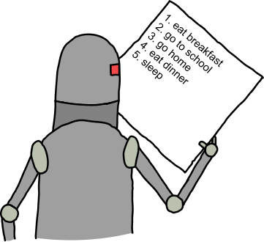
What is “Programming”?
A series of instructions that can be carried out by a computer
http://www.programmingbasics.org/en/beginner/img/commands4.png
Notes:
A program is a series of concrete instructions that can be carried out by a computer.
A program can be thought of as a script for a play, that will be performed by actors who follow instructions perfectly but without any intelligence of their own.

Slide 3
Alternate Terms
“Programs”
“Software”
“Application”
“Code”
But not "Codes" – it's always singular!
Notes:
Just a note on terminology: Programs are sometimes called "Software", "Applications", or "Code".

Slide 4

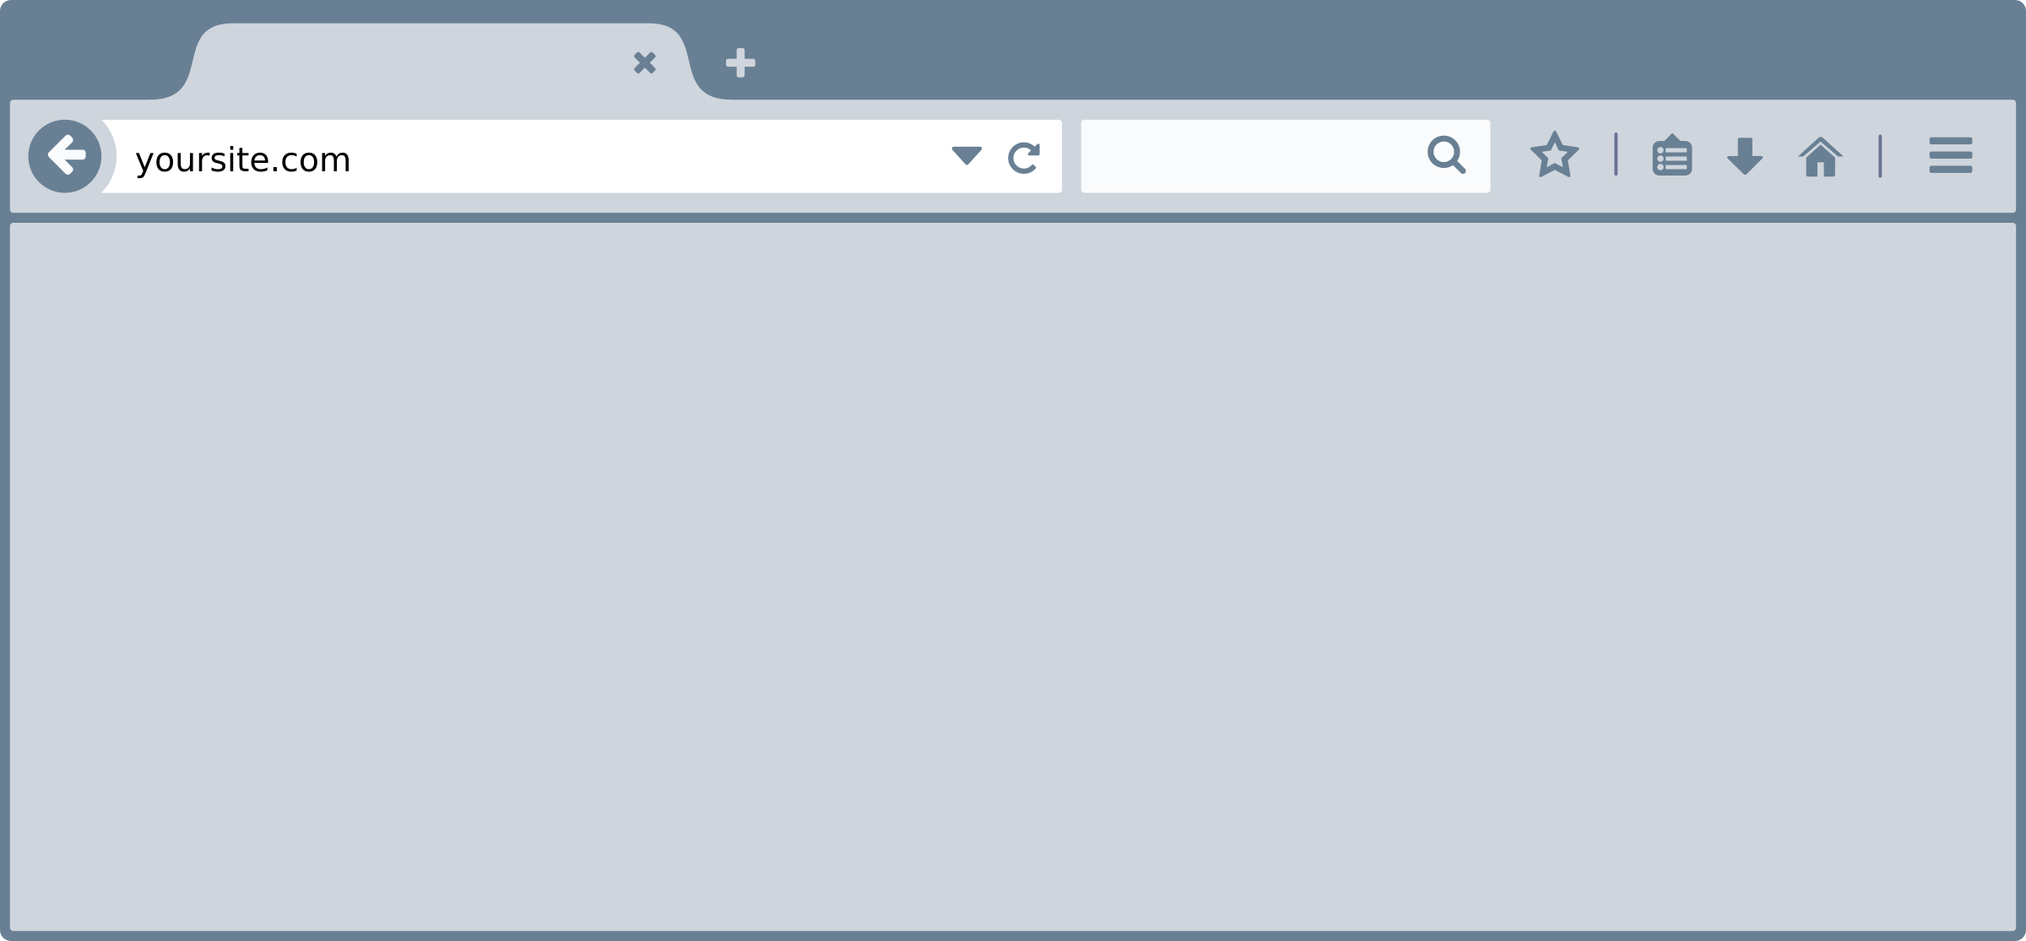
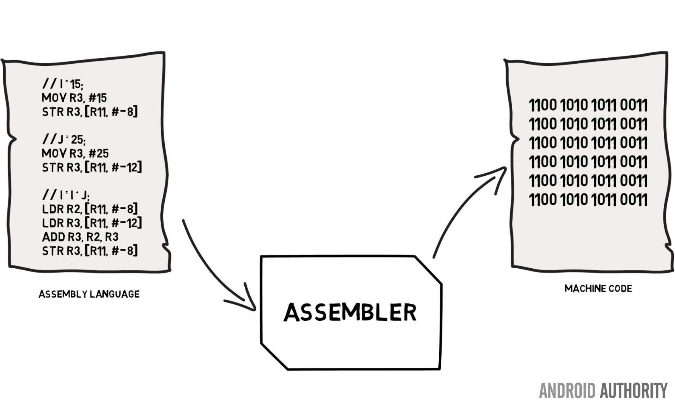

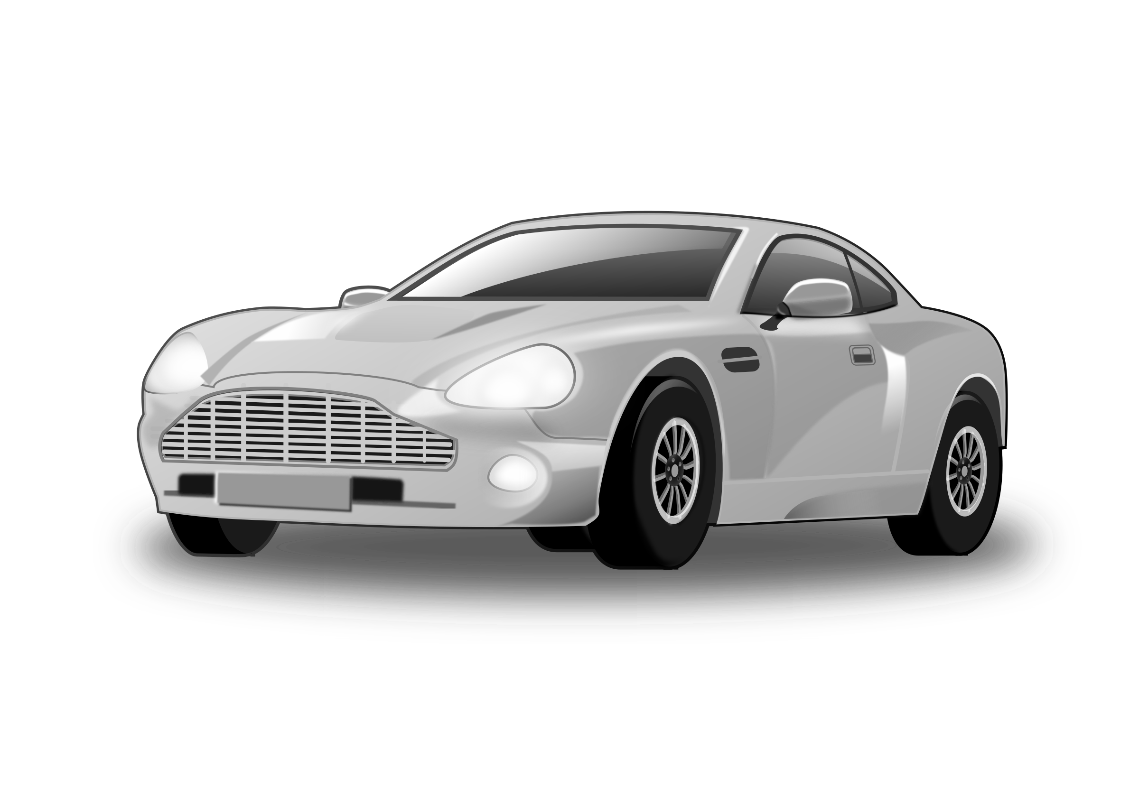
Programs are everywhere
https://openclipart.org/
Notes:
Everything on your computer is a program - your web browser, your music player, and even video games.
Programs can be run on laptops, phones, cars - almost everything runs programs now.

Slide 5

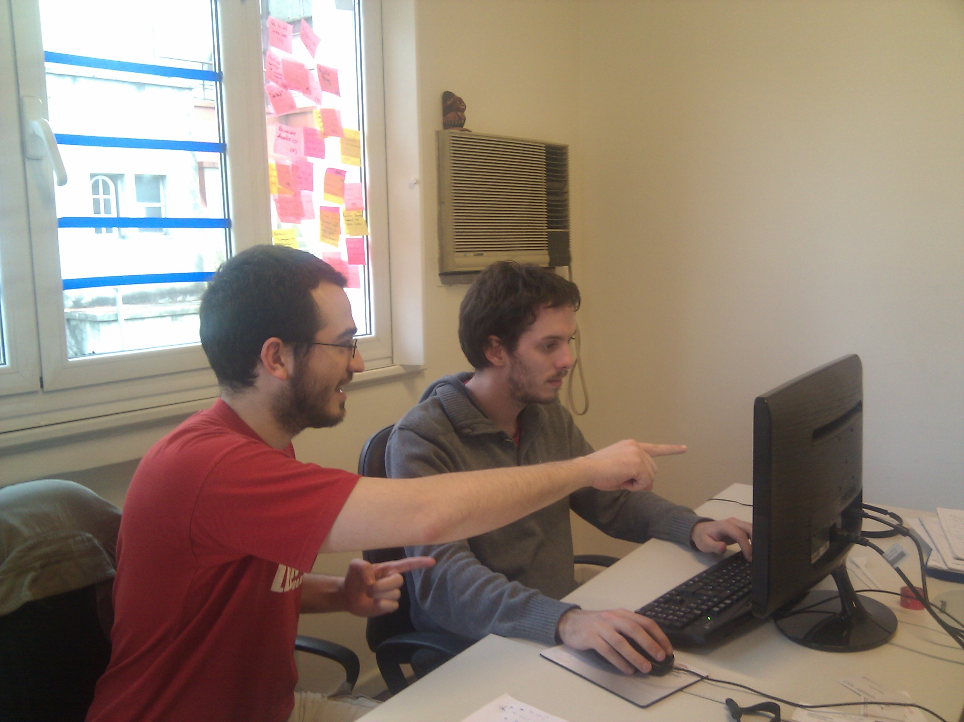
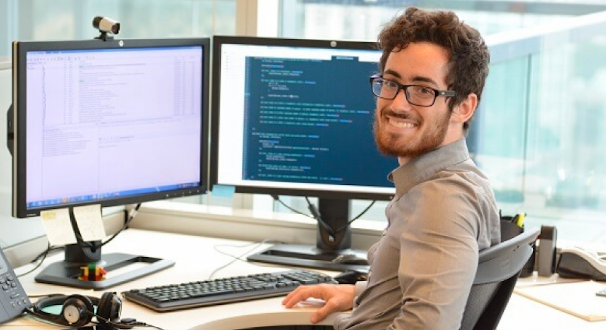
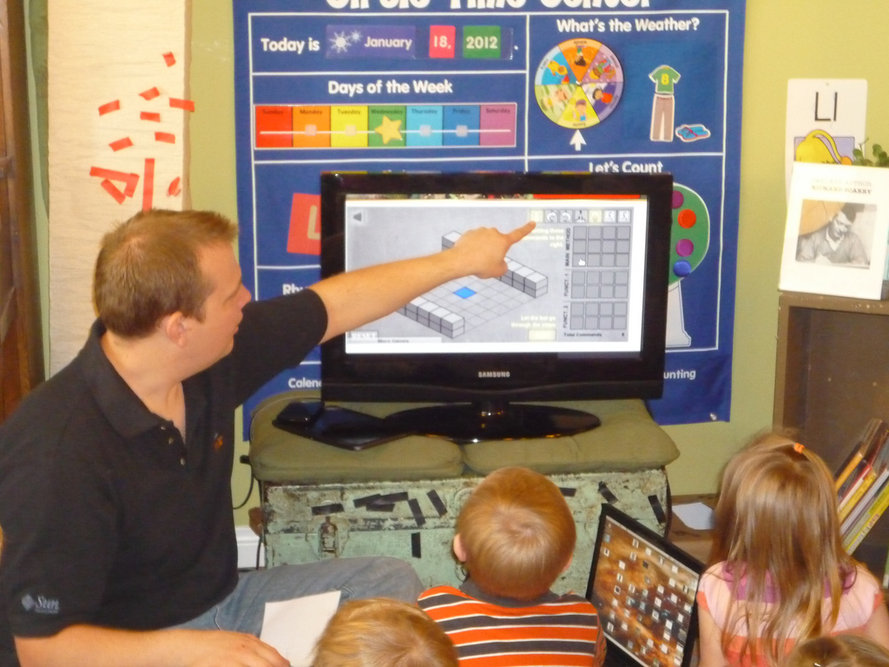
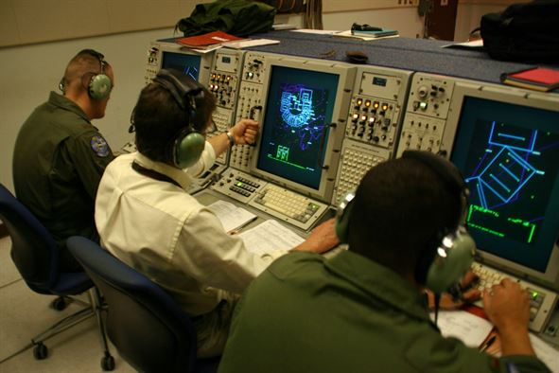
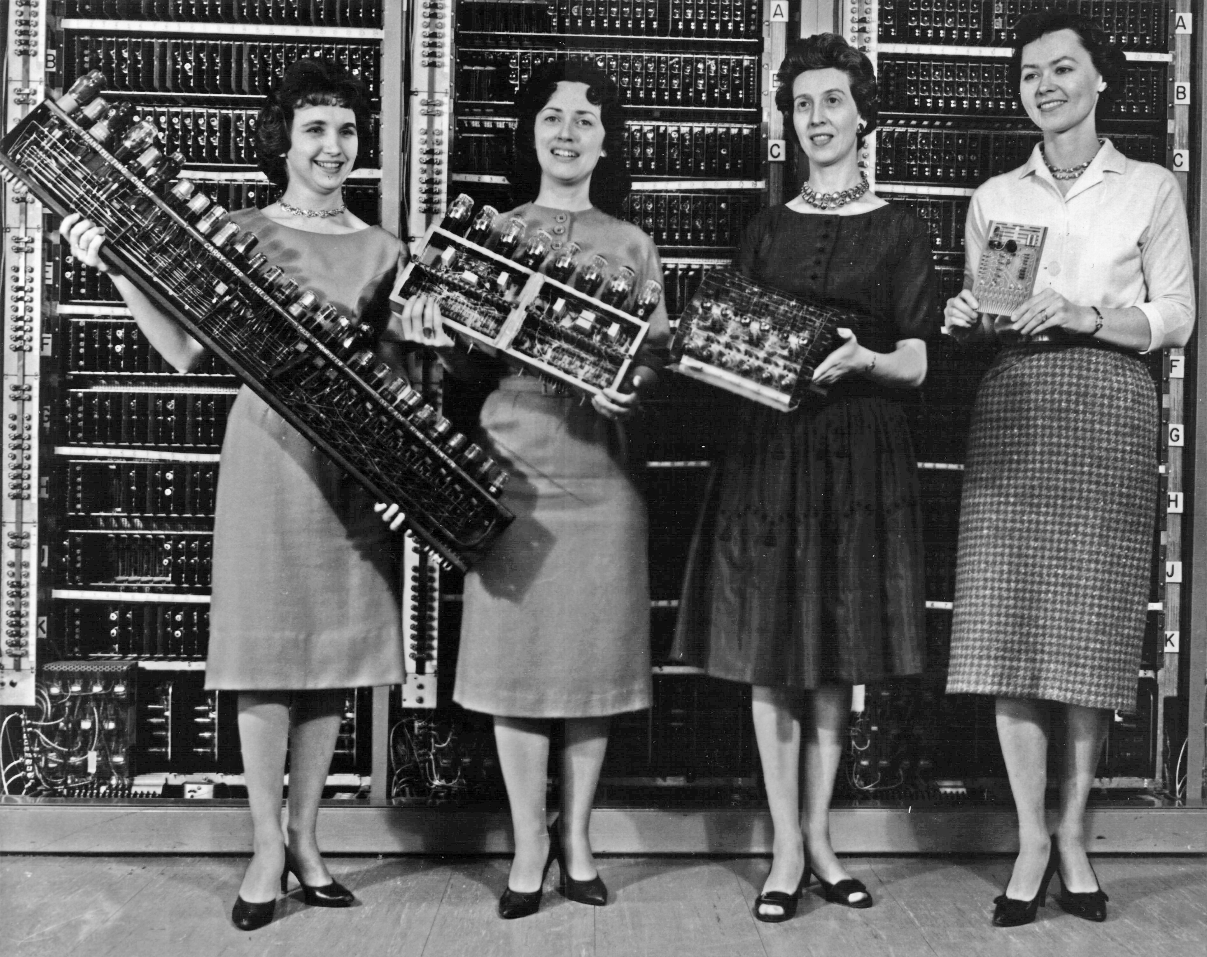
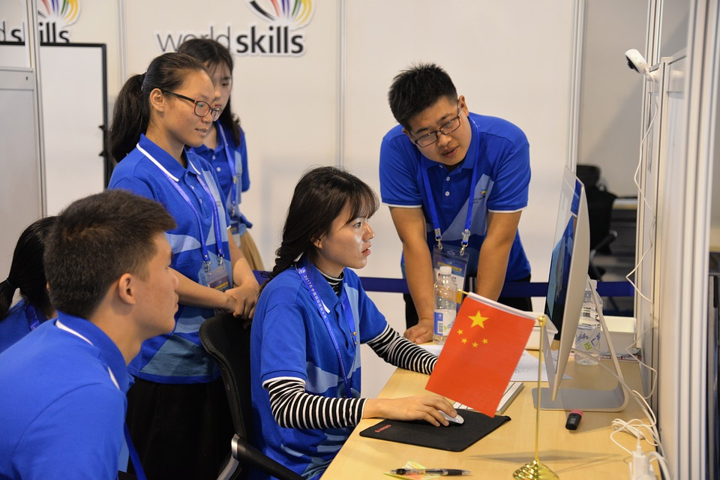
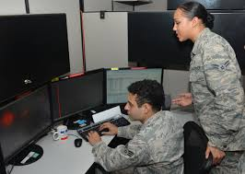
Programs do many things
Notes:
Programming now shows up in every field, from engineering to the sciences to even the arts and humanities.
Regardless of whether you want to be a Computer Scientist or just someone who knows a bit about programming, this is a skill that will come in handy.

Slide 6
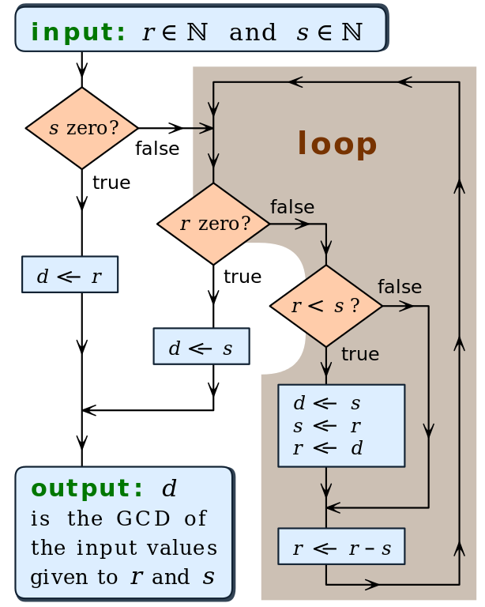



Is programming magic?
Magic
Precise Instructions
Notes:
You might think that some of the things that computers do are mysterious, but everything they do is the result of very careful instructions.
There may be many, complex instructions, but given time they are always understandable.

Slide 7
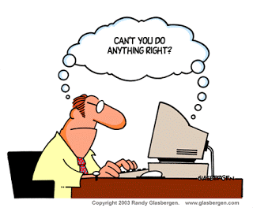
Limitations
Notes:
Although programming is very powerful, computers are not gods.
In fact, programs can only do what people have told them to do.
You must be very clear and explicit when writing programs.

Slide 8

In this Course
Notes:
In this course, you will learn how to write programs to solve problems.
You will not learn all there is to programming, so it is important that you also learn how to learn more.

